Slide 1




Deepfake Detection: Unmasking the Digital Impostors
Presented by: Ibrahim Mohamed Ezzat
ID: 211961
Supervisor: dr wael sersry

Slide 2









Agenda
Introduction
Background
Problem Statement
Objectives
Related Work 1
Related Work 2
Proposed Solution
System Architecture
Conclusion
Reference

Slide 3
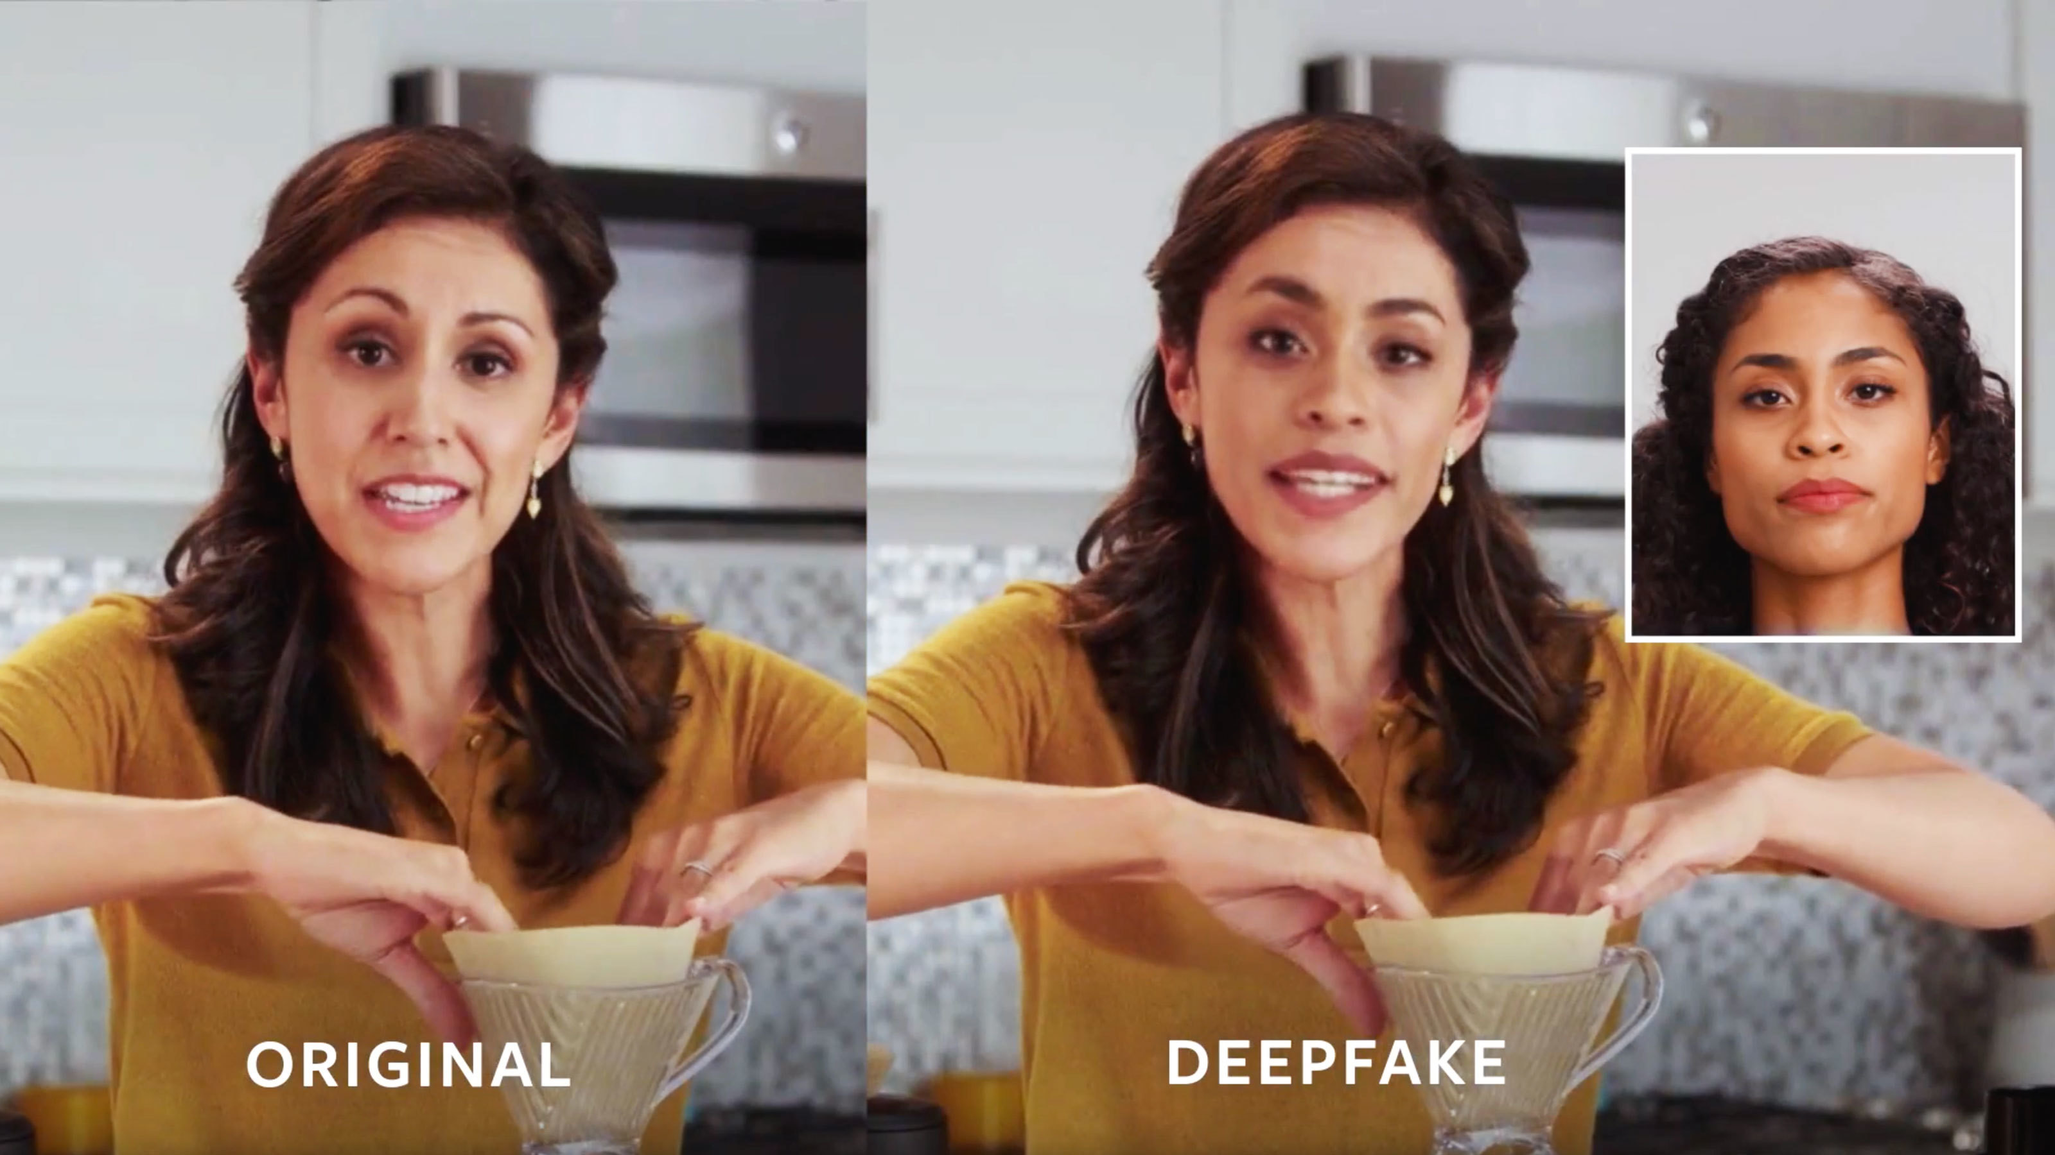
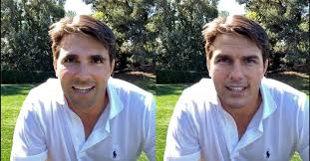
INTRODUCTION Deepfakes are a rapidly evolving and concerning facet of artificial intelligence and digital manipulation. These technologies allow individuals to create highly convincing and often deceptive content, such as videos, audio recordings, or images, that appear to be real but are entirely fabricated.

Slide 4
Background
The term "deepfake" consists of "deep learning" and "fake," signifying a class of media generated through advanced machine learning techniques.
Deep learning, a subset of machine learning, gained fame in the late 2010s with the development of deep neural networks, such as convolutional neural networks (CNNs) and recurrent neural networks (RNNs). These architectures excel in tasks like image recognition and natural language processing.

Slide 5
The Spread of Deceptive Deepfake Content
The main problem associated with deepfakes is the widespread dissemination of deceptive content that appears authentic but is entirely fabricated. This deceptive deepfake content includes manipulated videos, audio recordings, or images that can be used for various malicious purposes. Here are the challenges and dangers posed by deepfakes:
Misinformation
Political Manipulation
Trust Erosion

Slide 6
Objectives
Proposing a website to Detect whether a Photo is a deepfake or real
Evaluation
Create user-friendly tools and software that allow non-technical users, such as journalists and social media platforms, to detect and report potential deepfakes.

Slide 7
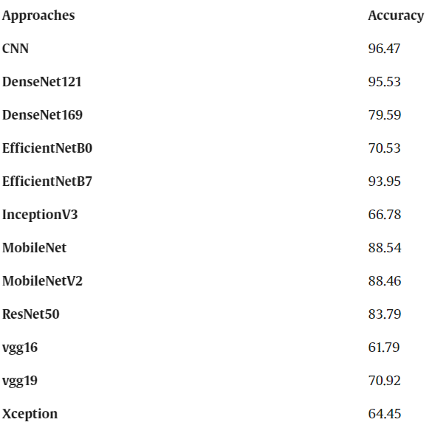
Related Work 1 DFT-MF: Enhanced deepfake detection using mouth movement and transfer learning 4 December 2021
Datasets: Vid-TIMIT, Celeb-DF , UADFV 795 synthesized videos and 408 real videos.
Methodology: CNN, DenseNet121, DenseNet169, EfficientNetB0, EfficientNetB7, InceptionV3, and so more
Limitations: Unclean data, filter on images, low quality images
Results:

Slide 8
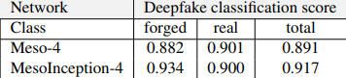
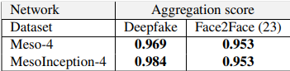
Related Work 2 MesoNet: a Compact Facial Video Forgery Detection Network September 2018.
Datasets: Deepfake, Face2Face
Methodology: Meso-4, MesoInception-4
Limitations: Blurry Images , Face barricades
Results:

Slide 9
Comparision of previous Solution
Related work 2 has an average detection rate of 98% for Deepfake videos and 95% for Face2Face videos under real conditions of diffusion on the internet.
In related work 1 This study has utilized the latest datasets including the Deepfake Forensics (Celeb-DF) dataset, the Deepfake Vid-TIMIT dataset and the UADFV dataset for the evaluation process. With DFT-MF, our method achieved a 71.29% accuracy rate on the Deepfake forensics (Celeb-DF) dataset, 73.1% on the Deepfake Vid-TIMIT-HQ and 89.7% on the UADFV dataset

Slide 10
Proposed Solution
In this project deepfakes will be detected by using Mesonet algorithm but with a better dataset that was used in (Related Work1)
The aim is to achieve better accuracy and evaluation that only can happen with a well done algorithm and a good dataset with high quality images and clean data

Slide 11
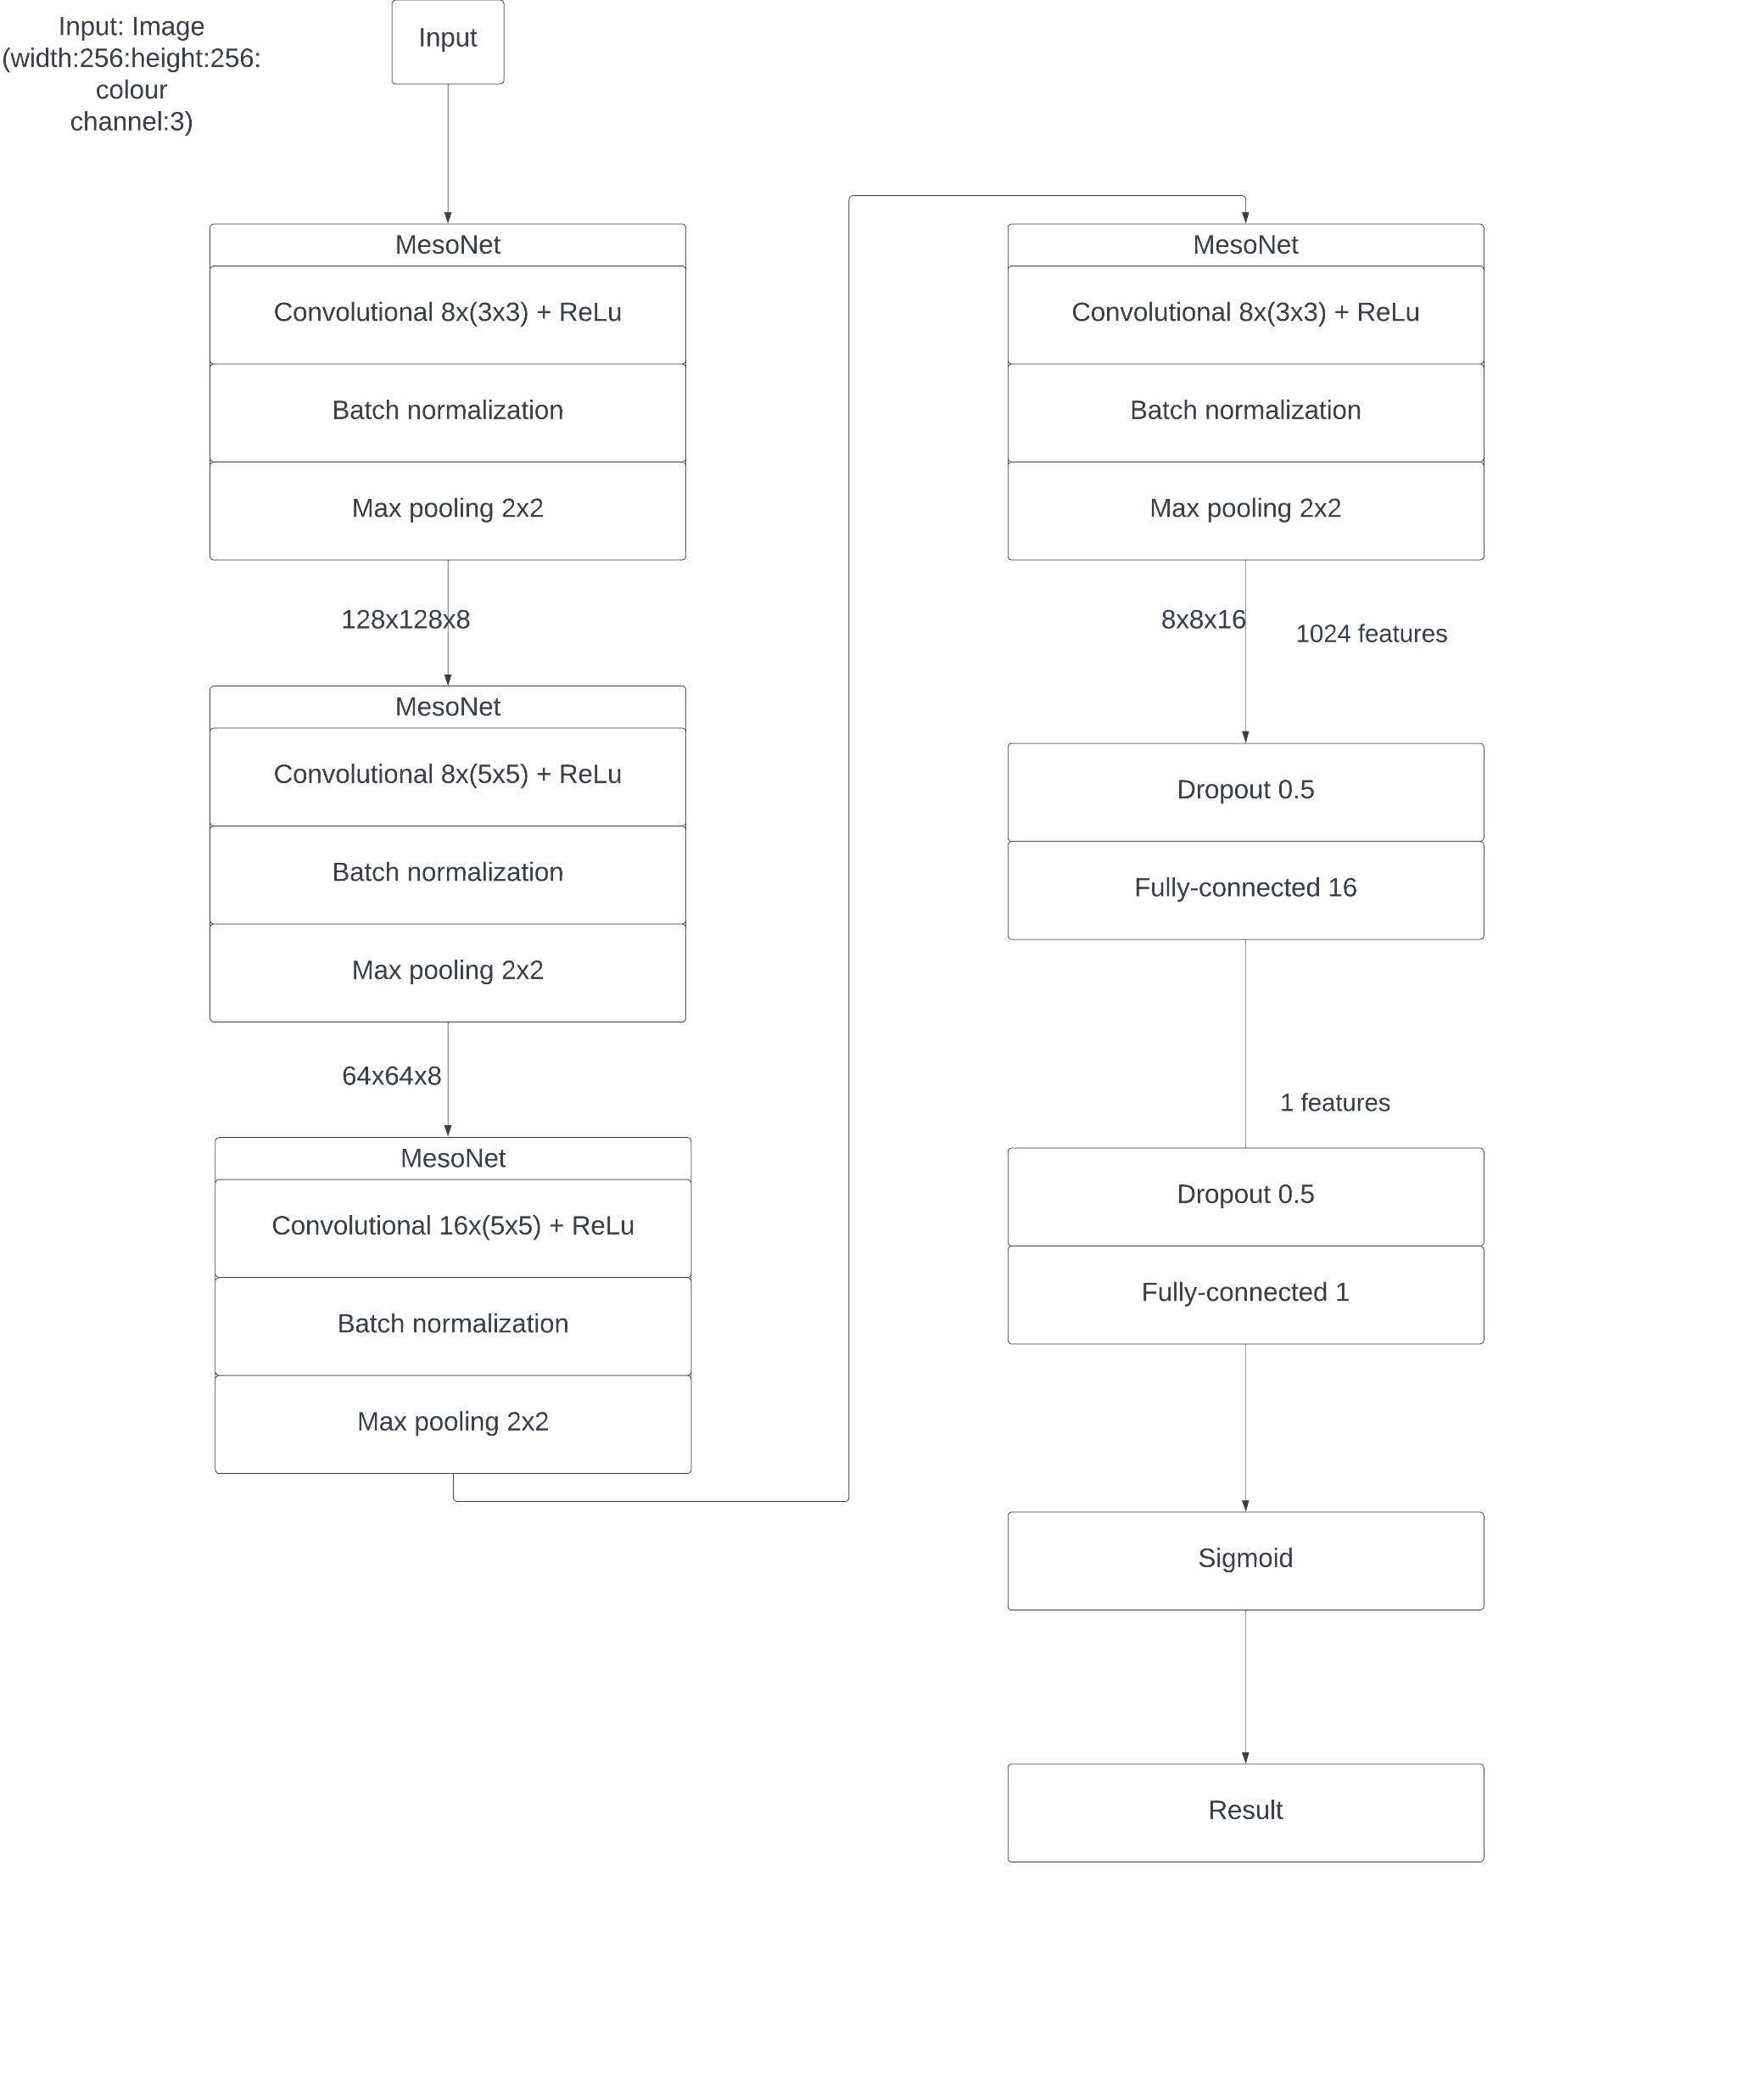
System Architecture
The system consist of 4 layers of convolutions and pooling
convolutions use ReLU
Batch Normalization to regularize their output and prevent the vanishing gradient effect
Dropout to regularize and improve their robustness.

Slide 12
Conclusion
In the end, deepfake detection is not just a technological challenge; it's a call to action to protect us from impostors and increase the trust and authenticity of our digital world. Thank you for your attention,

Slide 13
Reference
Jafar M.T., Ababneh M., Al-Zoube M., Elhassan A. Digital forensics and analysis of deepfake videos 2020 11th International conference on information and communication systems (2020)
B. Balas and C. Tonsager. Face animacy is not all in the eyes: Evidence from contrast chimeras. Perception, 43(5):355– 367, 2014.

Slide 14
Thank You

